Slide 1
Module-1
Introduction to Text Mining: Introduction, Algorithms for Text Mining, Future Directions 1.2 Information Extraction from Text: Named Entity Recognition, Relation Extraction, Unsupervised Information Extraction 1.3 Text Representation: tokenization, stemming, stop words, NER, N-gram modelling.

Slide 2
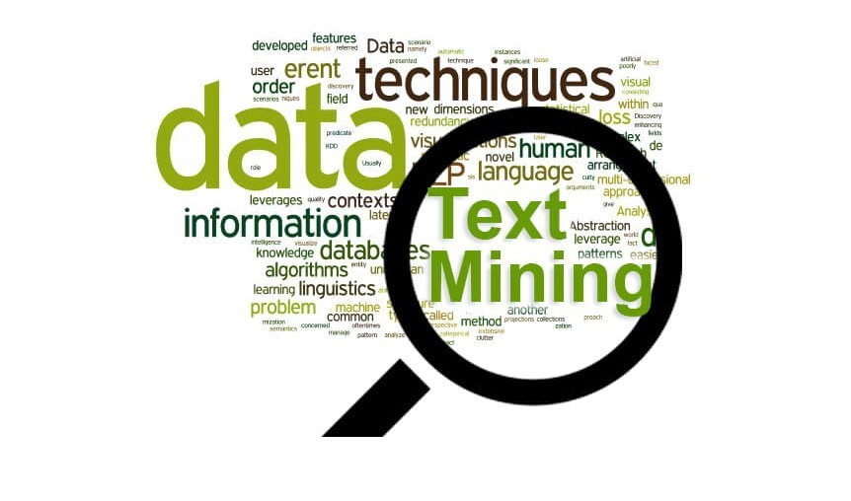
Introduction to Text Mining:
Text mining, also known as text analytics, is the process of deriving useful information from unstructured text data. It involves techniques and algorithms to extract patterns, insights, and knowledge from textual documents, enabling organizations to make informed decisions and gain valuable insights from their data.

Slide 3
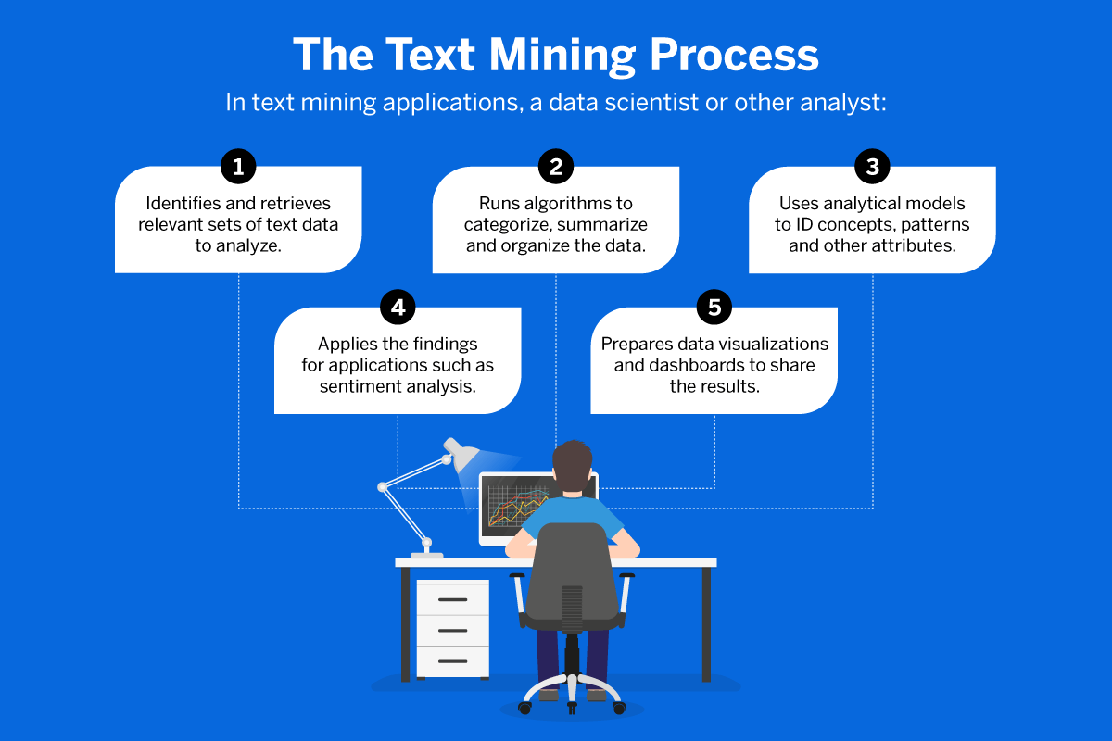
Algorithms for Text Mining:

Slide 4
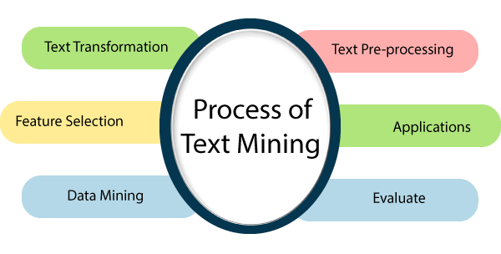

Slide 5
Natural Language Processing (NLP):
Natural Language Processing (NLP) algorithms are used to understand and interpret human language. Tasks such as sentiment analysis, text classification, and named entity recognition are performed using NLP techniques.

Slide 6
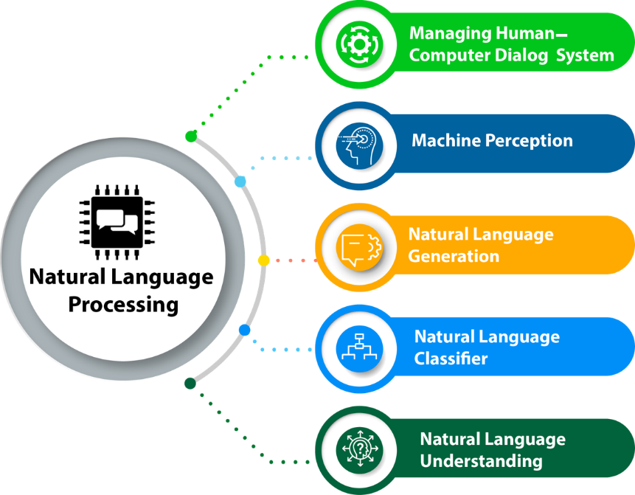

Slide 7
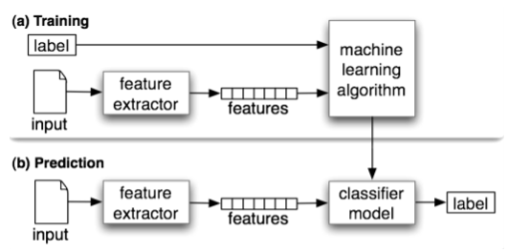

Slide 8
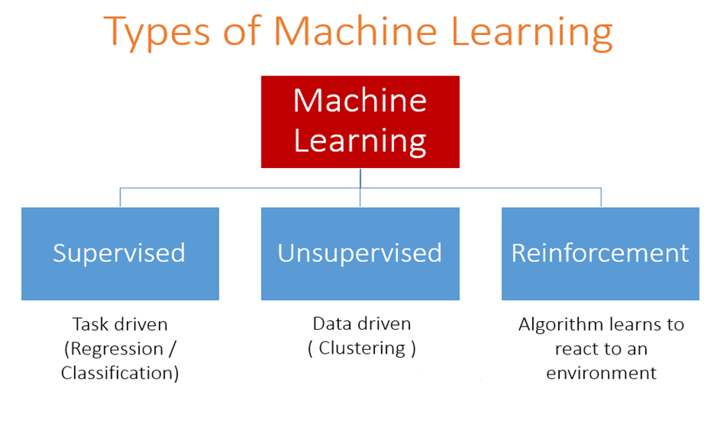
Machine Learning Algorithms:
Machine learning algorithms, including decision trees, support vector machines, and neural networks, are applied to text data for tasks such as text classification, clustering, and topic modeling. These algorithms learn patterns and relationships from labeled data to make predictions or categorize text documents.

Slide 9
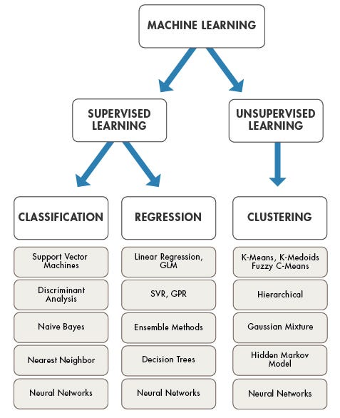

Slide 10
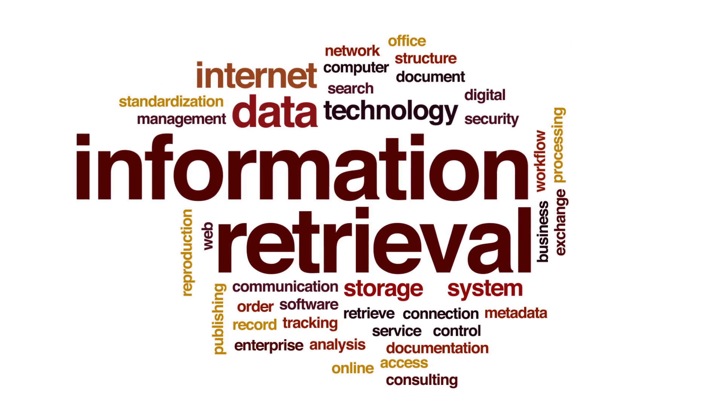
Information Retrieval Algorithms:
Information retrieval algorithms are used to retrieve relevant information from large collections of text documents. Search engines and recommendation systems employ information retrieval techniques to retrieve documents that match user queries or preferences.

Slide 11
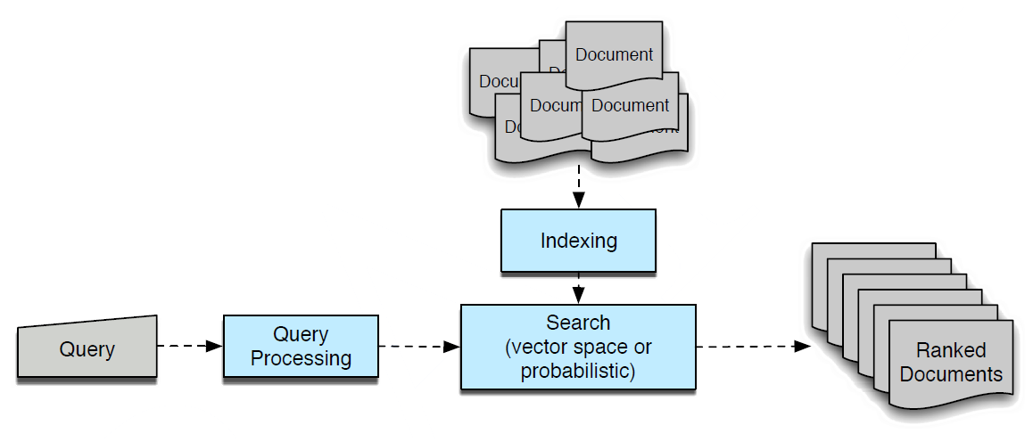

Slide 12
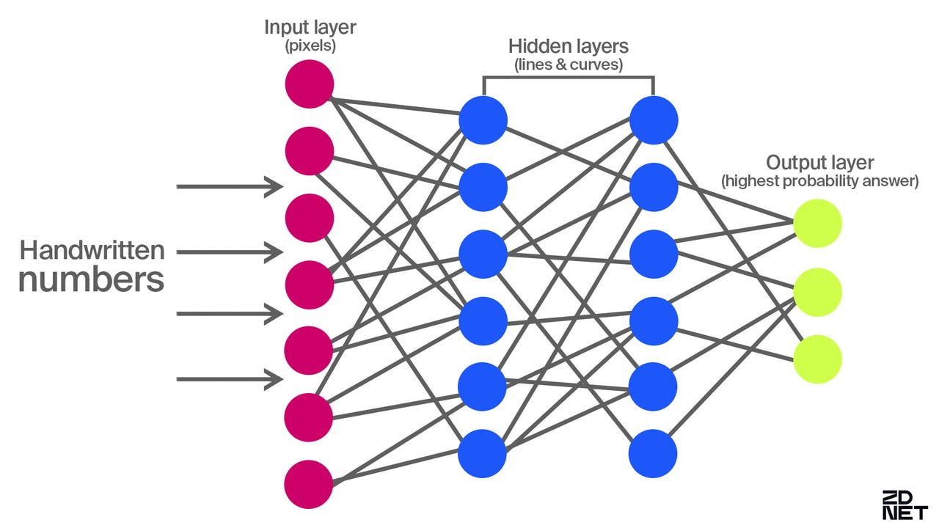
Future Directions- Deep Learning:
Deep learning techniques, such as convolutional neural networks (CNNs) and recurrent neural networks (RNNs), are expected to play a significant role in text mining. These techniques enable more accurate and sophisticated analysis of text data by learning hierarchical representations and capturing long-term dependencies.

Slide 13
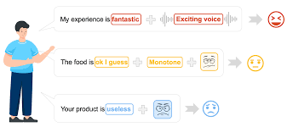
Multimodal Text Analysis:
There is a growing interest in combining text mining with other modalities, such as images, audio, and video, to gain deeper insights and improve analysis results. Multimodal text analysis techniques leverage multiple modalities to enhance understanding and interpretation of textual data.

Slide 14
Ethical and Social Implications:
Ethical and Social Implications: As text mining technologies become more powerful and widespread, there is a growing need to address ethical and social implications. Privacy concerns, biases in data and algorithms, and the responsible use of text mining technologies are some of the key issues that need to be addressed.

Slide 15
Information Extraction from Text:
Information extraction is a crucial task in text mining, involving the identification and extraction of structured information from unstructured text data. This process enables organizations to uncover valuable insights and knowledge hidden within vast amounts of textual information. Here, we delve into three essential techniques of information extraction: Named Entity Recognition, Relation Extraction, and Unsupervised Information Extraction.

Slide 16
Named Entity Recognition
Named Entity Recognition (NER) is the process of identifying and classifying named entities, such as persons, organizations, locations, dates, and numerical expressions, in text data. NER techniques are used to extract structured information from unstructured text documents.
Named Entity Recognition (NER) is a subtask of information extraction focused on identifying and categorizing named entities within text data. Named entities refer to specific entities such as persons, organizations, locations, dates, numerical expressions, and more. NER systems analyze text documents to locate and classify these entities into predefined categories. For example, in the sentence "Apple is headquartered in Cupertino, California," NER would identify "Apple" as an organization and "Cupertino, California" as a location.

Slide 17
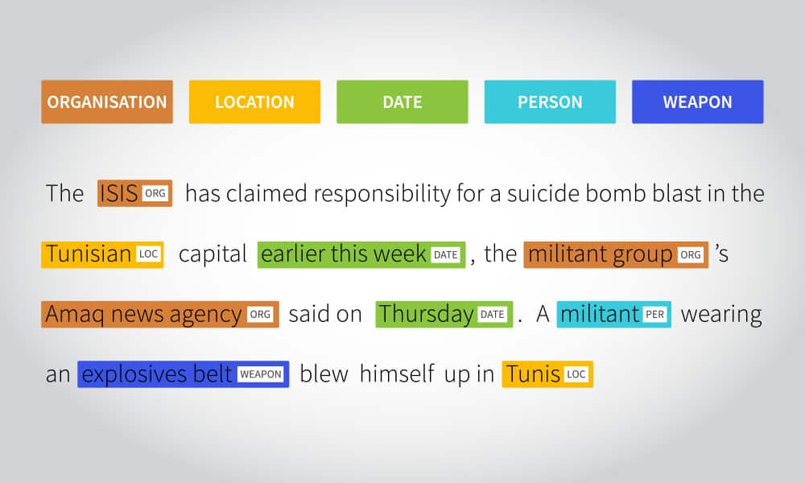
Cont..
Identifies and categorizes named entities within text data.
Entities include persons, organizations, locations, dates, numerical expressions, etc.
Utilizes rule-based, machine learning, and deep learning techniques.
Widely used in information retrieval, question answering systems, sentiment analysis, etc.

Slide 18
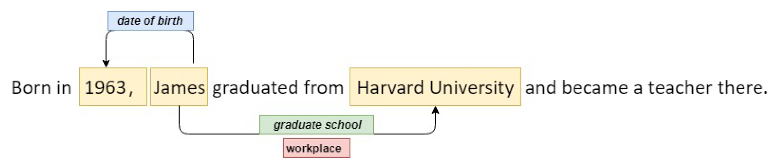
Relation extraction
Determines semantic relationships between entities mentioned in text data.
Focuses on identifying connections or associations between entities.
Techniques include supervised learning, pattern-based approaches, and knowledge graphs.
Applications in knowledge graph construction, information retrieval, question answering systems, etc.
Example: In the sentence "Mark Zuckerberg is the CEO of Facebook," relation extraction would identify the relationship between "Mark Zuckerberg" and "Facebook" as "CEO."

Slide 19
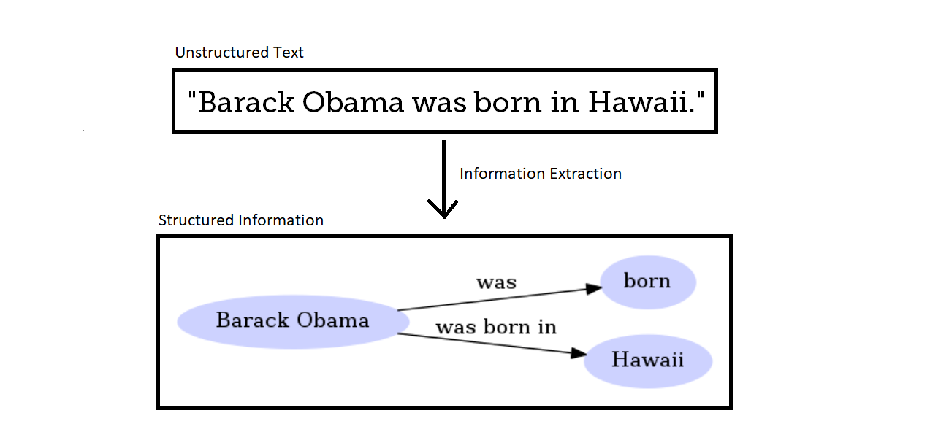
Unsupervised Information Extraction:
Discovers structured information from text data without labeled training data.
Leverages statistical models, clustering algorithms, and pattern discovery methods.
Includes text clustering, topic modeling, and semantic analysis techniques.
Valuable for document organization, summarization, and content discovery tasks.
Example: Using topic modeling on a collection of news articles, unsupervised information extraction could reveal common themes such as politics, sports, and entertainment without prior annotations.

Slide 20
Cont..
Text Representation: tokenization, stemming, stop words, NER, N-gram modelling

Slide 21
Tokenization
Tokenization is a fundamental text preprocessing technique used in Natural Language Processing (NLP) tasks. It involves breaking down a piece of text, such as a sentence or a document, into smaller units called tokens. These tokens typically represent individual words or phrases, making it easier for computers to process and analyze textual data.

Slide 22
Importance of Tokenization:
Text Processing: Tokenization is a crucial step in text processing pipelines as it enables computers to understand and manipulate textual data more effectively.
Feature Extraction: By breaking text into tokens, it becomes possible to extract meaningful features from the data, which can then be used in various NLP tasks such as sentiment analysis, document classification, and information retrieval.
Statistical Analysis: Tokenization facilitates statistical analysis of text data by providing a structured representation of the text, allowing for the computation of various metrics such as word frequencies and document similarities.

Slide 23
Techniques of Tokenization:
Word Tokenization: This technique involves splitting text into individual words based on whitespace or punctuation marks. For example, the sentence "Tokenization is important for NLP." would be tokenized into ["Tokenization", "is", "important", "for", "NLP."].
Sentence Tokenization: Sentence tokenization involves splitting text into individual sentences. This is particularly useful for tasks that require analyzing text at the sentence level, such as machine translation and text summarization.
Sub-word Tokenization: Sub-word tokenization breaks text into smaller units, such as morphemes or character n-grams, instead of complete words. This technique is commonly used for languages with complex morphology or in scenarios where the vocabulary size needs to be reduced.

Slide 24
Challenges in Tokenization:
Ambiguity: Some words or phrases may have multiple interpretations, making it challenging to determine the appropriate tokenization.
Special Cases: Certain cases, such as abbreviations, contractions, and hyphenated words, require special handling during tokenization to ensure accurate representation.

Slide 25
Stemming
Stemming is a text preprocessing technique used in Natural Language Processing (NLP) to reduce words to their base or root form, known as the stem. The goal of stemming is to normalize words with similar meanings so that variations of the same word are treated as identical during text analysis

Slide 26
Importance of Stemming:
Normalization: Stemming helps in reducing the dimensionality of the text data by converting different forms of a word into a common base form. This simplifies text analysis and improves the accuracy of downstream NLP tasks.
Information Retrieval: Stemming enhances information retrieval systems by ensuring that documents containing different forms of the same word are retrieved together. This improves search relevance and user experience.
Text Classification: Stemming aids in text classification tasks by treating variations of the same word (e.g., "run," "running," "ran") as instances of the same feature. This leads to more effective feature representation and better classification performance.

Slide 27
Stemming Algorithms
Porter Stemmer: Developed by Martin Porter in 1980, the Porter Stemmer is one of the most widely used stemming algorithms. It applies a series of heuristic rules to strip affixes from words and obtain their stems. While it may not always produce dictionary words, it is efficient and effective for many applications.
Snowball Stemmer (also known as the Porter2 Stemmer): An improvement over the Porter Stemmer, the Snowball Stemmer is more accurate and supports stemming for multiple languages. It provides better handling of irregular cases and is widely used in modern NLP applications.

Slide 28
Stop Words:
Stop words are common words that are frequently used in a language but often carry little semantic meaning. Examples of stop words include articles (e.g., "the," "a," "an"), prepositions (e.g., "in," "on," "at"), conjunctions (e.g., "and," "but," "or"), and other frequently occurring words (e.g., "is," "are," "have").

Slide 29
Noise Reduction: Stop words occur frequently in text but often do not contribute much to the overall meaning of the content. By removing stop words during text preprocessing, we can reduce the noise in the data and focus on the more meaningful words.
Memory Efficiency: Stop words tend to occur frequently in text data, and including them in text analysis tasks can significantly increase the size of the dataset. By removing stop words, we can reduce the memory footprint of the data and improve the efficiency of text processing algorithms.
Improved Performance: Removing stop words can lead to improved performance in text analysis tasks such as document classification, information retrieval, and sentiment analysis. By focusing on content-bearing words, we can extract more relevant features from the text and improve the accuracy of our models.

Slide 30
Approaches to Stop Word Removal:
Predefined Lists: Stop words are often removed using predefined lists that contain common stop words for a given language. These lists can be obtained from libraries or packages specific to the programming language or NLP toolkit being used.
Frequency-Based Removal: Another approach is to remove words based on their frequency of occurrence in the text. Words that occur above a certain threshold frequency are considered stop words and are removed from the text.
Contextual Stop Word Removal: In some cases, stop words may carry important contextual meaning and should not be removed. Contextual stop word removal techniques consider the context in which the words appear and make decisions about whether to remove them based on their semantic relevance.

Slide 31
N-gram modeling
N-gram modeling is a statistical language modeling technique used in Natural Language Processing (NLP) to predict the likelihood of a word given the previous N-1 words in a sequence. N-grams are sequences of contiguous items, typically words, characters, or subwords, extracted from a corpus of text.

Slide 32
Importance of N-gram Modeling:
Contextual Understanding: N-gram models capture the contextual relationships between words in a sequence, allowing for a deeper understanding of the text's structure and meaning.
Language Modeling: N-gram models are used to estimate the probability of word sequences occurring in a given language. This is essential for tasks such as speech recognition, machine translation, and text generation.
Feature Extraction: N-grams serve as features in various NLP tasks, such as sentiment analysis, named entity recognition, and text classification. They provide valuable information about the co-occurrence patterns of words in text data.
Applications of N-gram Modeling:
Text Generation: N-gram models are used to generate coherent and contextually relevant text by predicting the next word in a sequence based on the preceding words.
Spell Checking: N-gram models are used in spell-checking algorithms to identify and correct misspelled words based on their context within a sentence.
Machine Translation: N-gram models are used in machine translation systems to generate translations of text from one language to another based on the probability of word sequences occurring in each language.

Slide 33
Types of N-grams:
Unigram (1-gram): An individual word in a sequence without considering any context. For example, in the sentence "The cat sat on the mat," the unigrams would be ["The," "cat," "sat," "on," "the," "mat"].
Bigram (2-gram): A sequence of two consecutive words in a sequence. For example, in the same sentence, the bigrams would be ["The cat," "cat sat," "sat on," "on the," "the mat"].
Trigram (3-gram): A sequence of three consecutive words in a sequence. For example, in the same sentence, the trigrams would be ["The cat sat," "cat sat on," "sat on the," "on the mat"].

